Slide 1
Choosing an FFT size
Previous formulas gave us one frequency component for each bin
FFT of size N has (N/2+1) unique bins after accounting for symmetry
Tells us maximum number of frequency components we can represent
N time-domain samples ↔︎ N frequency-domain bins
Larger FFT → greater frequency resolution
Bins spaced more closely together in frequency: 2πk/N
Easier to resolve two closely-spaced frequency components of signal
Trade off:
Fundamental mathematical limitations
Resolving short transient events within long time window is difficult
Poor time resolution, long latency

Slide 2
Choosing a hop size
How often should we take FFT?
If we want to reconstruct signal, hop size H must be no more than FFT size N
Advantages of smaller hop sizes
More frequent time snapshots of signal
Phase of each bin advances less from one hop to next,
improving frequency estimation
Some types of window need a hop size of N/2, N/3 or even less to reconstruct the signal
Lower latency for phase vocoder effects
Disadvantages of smaller hop sizes
More computationally expensive
Hop sizes that aren’t integer division of FFT size can lead to reconstruction artifacts
H = N
H = N/2
H = N/4

Slide 3
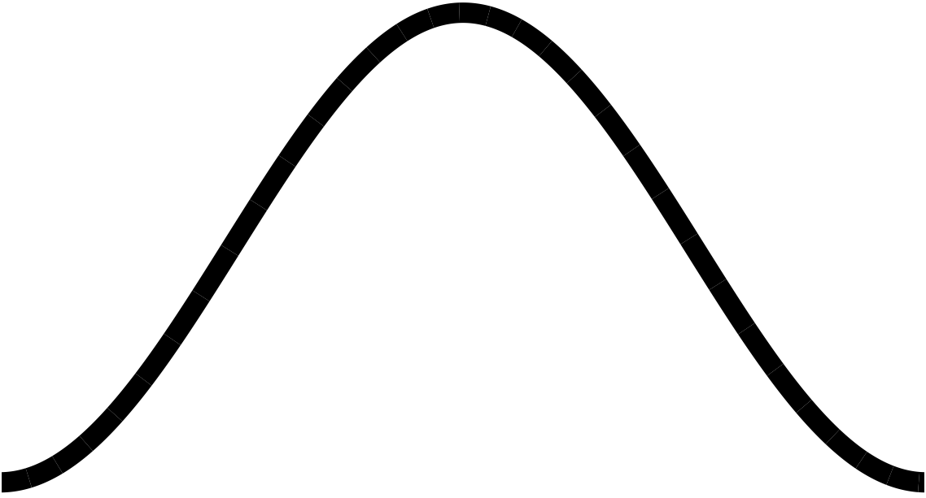
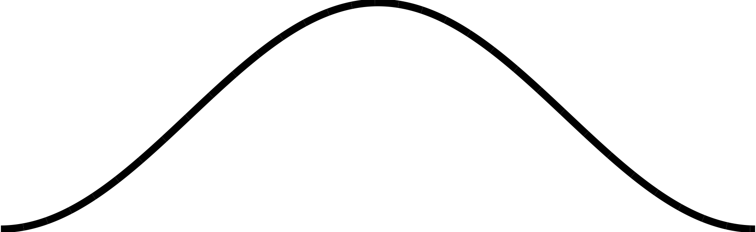
Windowing
Overlap-Add process segments signal into finite-length windows
These segments can have discontinuities at the edges (assuming 0 outside the window)
Might not notice this if we just reconstruct the signal with no frequency-domain processing
If we modify signal, these sharp edges can lead to crackling or buzzing sounds
Can use window function to taper the edges
Pre-calculated shape that we multiply the segment by before FFT
H = N/4
sharp edges
Hann window

Slide 4
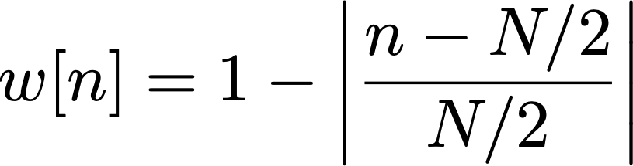


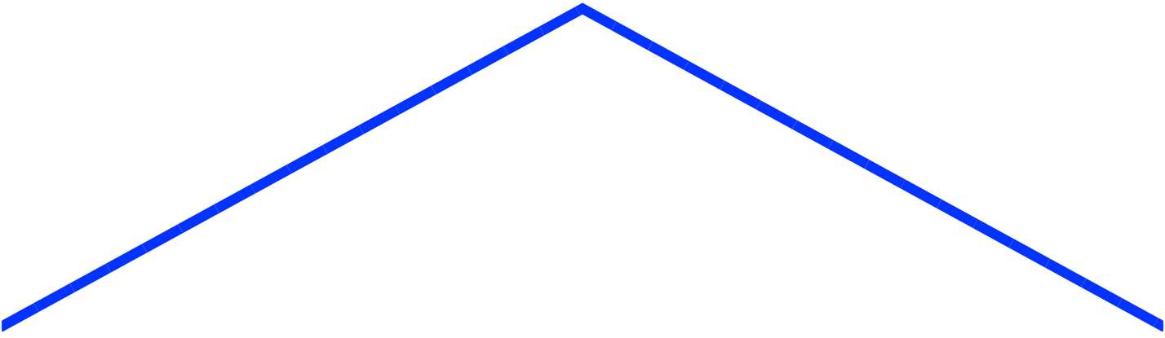
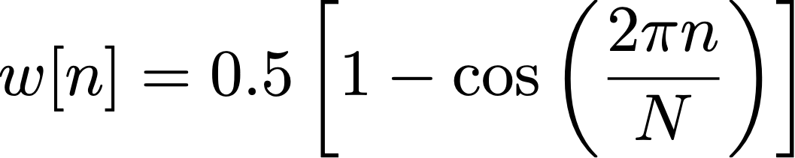
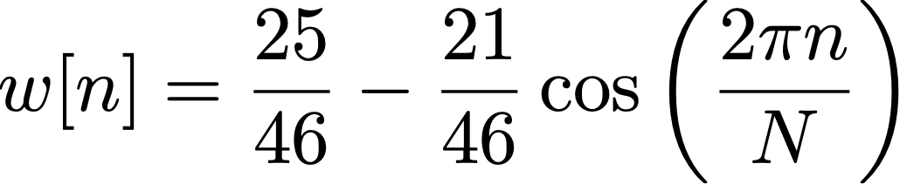
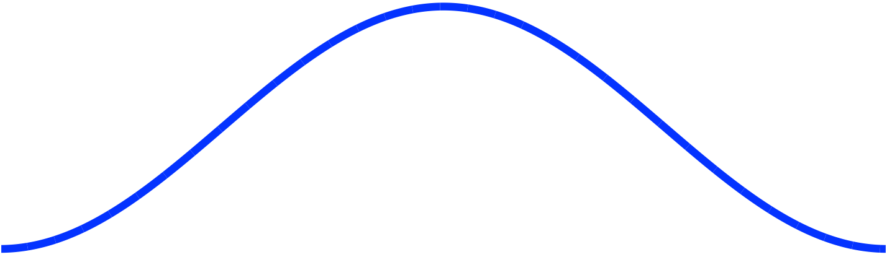
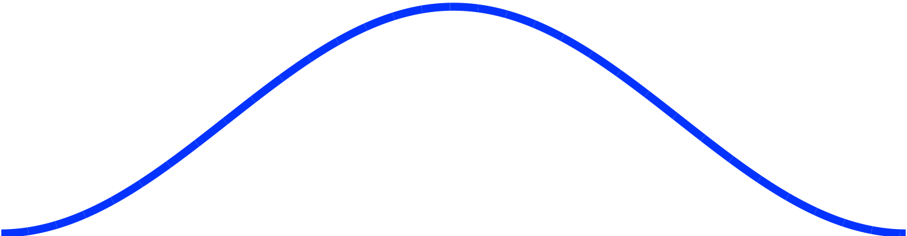
Types of window function
Rectangular
Triangular (Bartlett)
for
Hann
Hamming

Slide 5
Effect of rectangular window and Hann window applied to signal

Slide 6
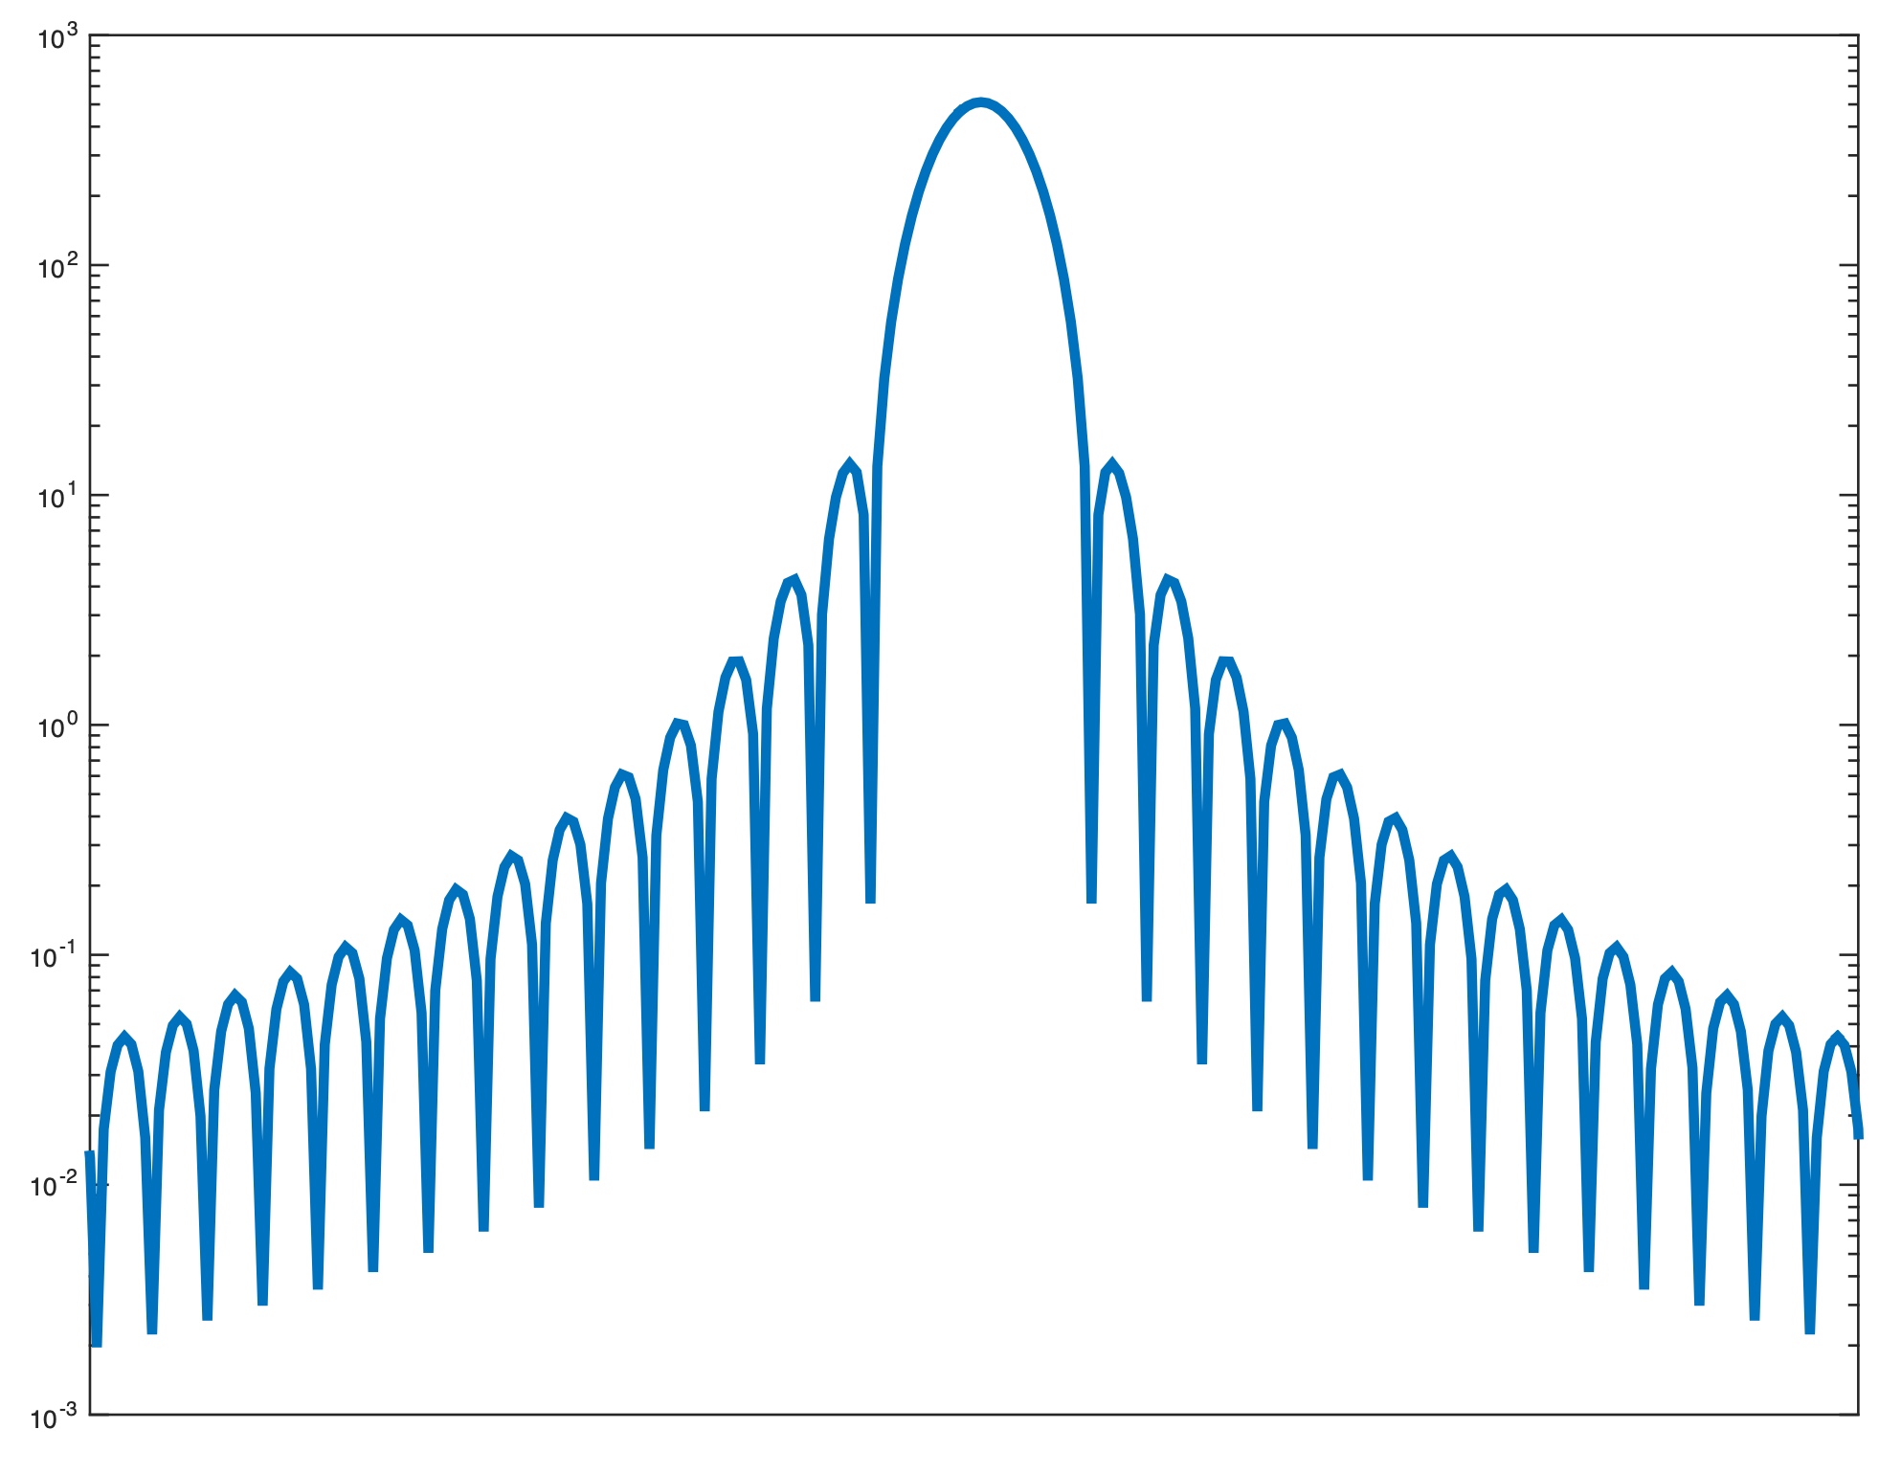
Window spectra
Windowing lets us isolate segment of signal
Cost is smearing of energy in frequency domain
Energy appears at frequencies where it doesn’t exist in original signal
Each frequency component of signal appears as series of lobes
Main lobe: broad peak centred around actual frequency
Side lobes: secondary peaks at other frequencies
Typically want to minimise:
Main lobe width
Side lobe height
Side lobe height
(expressed in dB)
Main lobe width
(expressed in
frequency)
Hann-windowed
spectrum
(frequency smearing)
ideal signal
(all energy at one
frequency)

Slide 7
Coding a window
Most efficient to pre-calculate window when program starts
Then recalculate when settings change: window size, window type etc.
Store window in an array (typically a global variable)
Array length equal to window size
To calculate, use for() loop to iterate over each sample of window
To apply, multiply signal by window buffer frame-by-frame
Could do this while unwrapping circular buffer
const int windowSize = 1024;
float windowBuffer[gWindowSize];
for (n = 0; n < windowSize; n++)
windowBuffer[n] =
equation for window
for(unsigned int n = 0; n < windowSize; n++) {
windowedSignal[n] = originalSignal[n] * windowBuffer[n];
}

